Slide 1
Me and My Friends 我和我的朋友
Middle School
Designed by
Ya-Ching Hsu, Li-Ling Cheng, Shu-Hui Huang,
Zhonglian Liu,Ying Zhang

Slide 2
Day 1
Teaching Instruction

Slide 3
Day 1: Review/Activate prior knowledge
Objectives:
1) Students will be able to introduce
his/her best friend’s name, age, grade and hobbies. 2) Students will be able to use background information to predict the possible
information on the email based on the
first sentence of the text and then
report to the class.

Slide 4
Activity 1: (10 minutes)
Each student will interview a classmate about his/her best friend and write down the information on the worksheet (work sheet, next slide).
Use clock buddy to pair students. (see slide #6)

Slide 5
小明，
你好！今天我想给你介绍我的好朋友…
Predict:
(1) ____________________________
(2)_____________________________
(3)_____________________________

Slide 6
http://www.docstoc.com/docs/18645794/Clock-Buddies---PDF

Slide 7
Activity 2 (related to activity 1): (20 minutes)
Students compile the collected information.
Pair work: Tell another classmate about the classmate that you interview.
The teacher invites two students to report to the class.

Slide 8
Activity 3: Pre-Reading: (15 minutes)
Make prediction
(Small group discussion) Students
read the first sentence of the email and predict what the email
is about.
Group report

Slide 9
Activity 4: Skimming (15 minutes)
Scan the main ideas in first and second paragraph

Slide 10
小明：
你好！今天我想给你介绍我的好朋友。
我的好朋友叫小丽，她今年十三岁了。她上初中一年级。 小丽长得很可爱，她的头发又黑又长，眉毛浓浓的，鼻子高高的，眼睛大大的。
小丽喜欢玩捉迷藏，还喜欢跑步。她每天都去跑步，跑得非常快，所以我们都叫她“飞毛腿”。

Slide 11
Q1: Who is the main character?
____________
Q2: Find one word to describe the
main character?
____________
Q3: What’s the main character
favorite game?
_____________
Q4: What’s the main character’s
hobby? ___________

Slide 12
Activity 5: Pre-assessment (10 minutes)
Students skim the text and underline the words unknown to them.
Students write down the unknown words on a blank chart.
The teacher collects the charts and uses them as resource to prepare for Day 2 lesson plan.

Slide 13
Activity 6: Fun with the word
“飞“，”毛“，”腿” (2 minutes)
(pinyin) | (pinyin) | (pinyin)
飞 | 毛 | 腿
(meaning) | (meaning) | (meaning)

Slide 14
飞毛腿
fēimáotuǐ
http://hosted.verticalresponse.com/568614/b24cbc1348/1383098273/d319b39228/

Slide 15
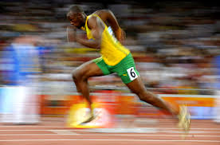
Uasin Bolt
http://www.tropicalsky.co.uk/blog/caribbean-infographic-usain-bolt/
Bolt跑得很快。
他是______。
飞毛腿

Slide 16
Day 2
Teaching Instruction

Slide 17
Day 2 我和我的朋友
Objectives:
Describe a person’s appearance using newly learned words and grammatical structures
Compare after-school activities in China and USA.

Slide 18
小明：
你好！今天我想给你介绍我的好朋友。
我的好朋友叫小丽，她今年十三岁了。她上初中一年级。 小丽长得
很可爱，她的头发又黑又长，眉毛浓浓的，鼻子高高的，眼睛大大的。
小丽喜欢玩捉迷藏，还喜欢跑步。她每天都去跑步，跑得非常快，所以我
们都叫她“飞毛腿”。
上个星期六早晨，小丽来找我和小东玩捉迷藏。我们用剪刀、石头、布决定
谁当猫，结果小丽当猫。游戏一开始，我和小东就赶快去藏好。小丽找到了我，然后又找到了小
东。第二次，我当猫。我一会儿就找到了小东，可是我找了很久都没找到小丽，最后终于在一个
大箱子里找到了她。那天我们大家都玩得很开心。
请你给我介绍一下你的好朋友，好吗？
王小龙

Slide 19
Cont. Activity 1:
Step 4: Use all the new characters and pictures to make sentences.
小云有浓浓的眉毛。
小雨有淡淡的眉毛。
我喜欢 浓浓的牛奶（果汁，咖啡，茶，汤）。
Uasin Bolt 是飞毛腿。
弟弟喜欢捉迷藏。
我们用剪刀剪双喜字。
爸爸和妈妈决定星期六吃中餐。
小龙不喜欢当老师（画家，司机，学生）。

Slide 20
Radicals For each of the following 3 groups, find the characters with a certain radical.
A 上海 长江 鸡汤 洗手 浓浓的 黄河 部首 氵
B 打篮球 捉迷藏 拉手 排球 拍手 摇摇 部首 扌
C 苹果 草莓 香蕉 捉迷藏 部首 艹

Slide 21
Activity 2: Grammatical structure 长得.....
Step1（Teacher-led) Use pictures of celebrities to introduce and practice this structure.
Q: 她/他长得怎么样？
A：她/他长得很可爱。
Step 2：中文歌 虹彩妹妹
http://www.youtube.com/watch?feature=player_detailpage&v=uzq7jCpk_OE#t=12s
Step 3：Describe your classmate’s look
Have one student come to the front
The rest of class will use the new structure 长得 to describe this student’s look.

Slide 22
Grammatical structure 长得.....
她长得（好看，漂亮，可爱），她的头发很长/短/黄，眉毛（浓浓的），鼻子（小小）的，眼睛蓝蓝的，大大的。
http://www.abortionsarewrong.com/Baby-Pictures/2013/05/17/cute-baby-girl-picture-field/

Slide 23
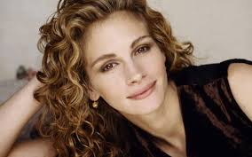
Grammatical structure 长得.....
她长得 （ ），她的头发（ ） ，眉毛（ ），鼻子（ ），眼睛（ ）。
http://www.fansshare.com/gallery/photos/67718/Julia-Roberts-Hair/

Slide 24
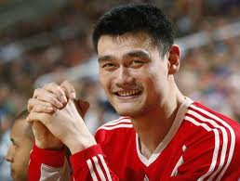
Grammatical structure 长得.....
http://yaomingblog.com/
otvet.mail.ru
姚明长得（ ），他的头发（ ），眉毛（ ），鼻子（ ），眼睛（ ）。

Slide 25
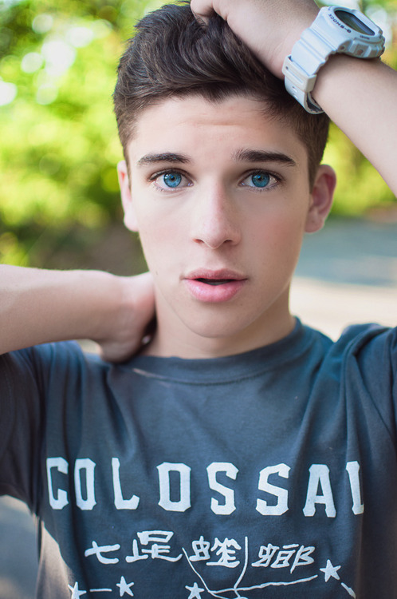
Activity 3: 用”长得.....”描写我的好朋友
介绍你的好朋友：
Describe your best friend’s appearance.
范例：
我的好朋友叫小杰。小杰长得很好看，他的头发很长，眉毛浓浓的，鼻子高高的，眼睛蓝蓝的，大大的。
http://suchcuteguys.tumblr.com/post/33683971605

Slide 26
我的好朋友叫小丽，她今年十三岁了。她上初中一年级。 小丽长得很可爱，她的头发又黑又长，眉毛浓浓的，鼻子高高的，眼睛大大的。
小丽喜欢玩捉迷藏，还喜欢跑步。她每天都去跑步，跑得非常快，所以我们都叫她“飞毛腿”。

Slide 27
Activity 4: Skim and Read paragraph 1 &2
Skim the two paragraphs to identify the main information, using the following guiding questions.
Q1: 谁是小龙的好朋友？
Q2: 小丽多大了？
Q3: 小丽上几年级？
Q4: 小丽长得怎么样？
Q5: 小丽喜欢玩什么？
Q6: 为什么小丽的朋友叫她“飞毛腿”？

Slide 28
Activity 5: Students compare after-school activities.
Step 1: Watch the video:
“捉迷藏”
Step 2: Discusses the differences between “捉迷藏” and “Hide and seek,” such as the word order and rules.
Step 3 : Teacher guide students to Compare after school activities from China and USA.

Slide 29
Activity 6
Review new words by play a game created by Tagxedo
.

Slide 30
Homework: Fill in the blanks about your best friend, then draw a picture of him/her.
我的好朋友叫______，她/他今年______岁了。她/他上_________。
她/他长得很______，她/他的头发__________，眉毛______，鼻子
____________，眼睛__________。
她/他喜欢玩_______，还喜欢________。

Slide 31
Day 3
Teaching Instruction

Slide 32
Day 3: During Reading (完成文章后半段)
Use the grammatical pattern (先、然后、最后) to describe event sequence.
Compare the difference of the term of the hand game “剪刀石头布” and “Rock Paper Scissors”.

Slide 33
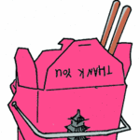
Activity 1: 先、 然后、最后
(20 minutes)
Step 1: (teacher-led) TPRS
先 ，
然后 ,
最后 。
老师
Source 1
吃饭
看书
睡觉

Slide 34
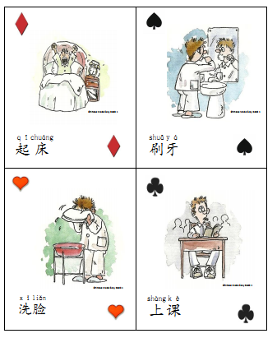
Step 2: Charade
Sentence Pattern:
Subject +先…，然后…，最后…。
Exercise: see “Sentence Pattern Playin gcard
example

Slide 35
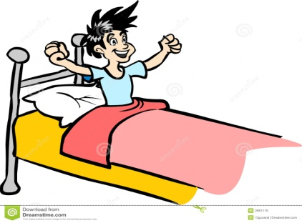
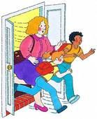
See Day 3 Task sheet
1. 起床以后，
我先
然后
最后
。
，
，
http://www.fotosearch.com/illustration/school-bell.html
2. 放学以后，
我先
然后
最后
。
，
，

Slide 36
Activity 2: Fun with Chinese hand game
剪刀石头布 (10 minutes)
http://www.nipic.com/show/3/81/1b3fac3aeacfae3f.html
Source 4
Source 2
Source 3
剪刀
石头
布

Slide 37
Demonstrate how to play 剪刀石头布.
Students play 剪刀石头布
Think-Pair-Share: Students will be able to compare the different
terms of Chinese hand game “剪刀石头布” with American
“Rock Paper Scissors”.

Slide 38
Paragraph 3
上个星期六早晨，小丽来找我和小东玩捉迷藏。我们用剪刀、石头、布决定谁当猫，结果小丽当猫。游戏一开始，我和小东就赶快去藏好。小丽先找到了我，然后又找到了小东。第二次，我当猫。我一会儿就找到了小东，可是我找了很久都没找到小丽，最后终于在一个大箱子里找到了她。那天我们大家都玩得很开心。

Slide 39
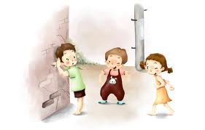
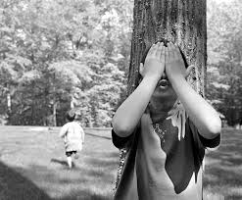
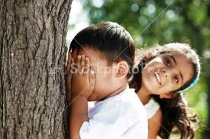
Skim Paragraph 3 and fill in the answers in the following form.
时间 | 几个人 | 玩什么 | 怎么玩 | 谁当猫 | 玩得怎么样？
Draw comic strips to demonstrate how to play ‘hide and seek,’ as shown below.
Write a short description for each drawing.

Slide 40
作业Homework:
Students use Google Voice, cell phone to record what he/she did today after school in sequence.
Students use Google Voice, cell phone to record what he/she did today after school in sequence.
Use the online dictionary ‘yellow bridge’ to look up the new words. Write down the meaning and pinyin for each word, and make a sentence using the word.
帅，酷，好看，英俊，可爱，壮， 高,
漂亮，可爱，好看，美丽，苗条

Slide 41
Source:
1. http://my.cheng-tsui.com/node/1441
2. http://www.book-in-a-
week.com/2011/09/when-to-cut-a-
scene/scissors-2-2/
3. http://www.pixmac.com/picture/boulders
/000050549883
4. http://openclipart.lynms.edu.hk/
index_214.html

Slide 42
DAY 4
Teaching Instruction

Slide 43
Objectives
Describe a person’s appearance
Reply his/her pen pal’s email using the new words and sentence patterns

Slide 44
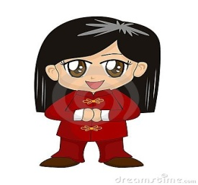
Activity 1: Main ideas for each paragraph (small group activity)
Summarize the main idea of each paragraph in one sentence (in English).
Identify key words and examples to provide supporting details (graphic organizer ).
Main Idea:
Key word:
Examples:
Main Idea:
Key word:
Examples:
Main idea:
Key word:
Examples:
http://www.clker.com/clipart-blank-face-boy.html
http://www.dreamstime.com/stock-images-cute-chinese-cartoon-girl-image1452264
http://www.picturesof.net/pages/080711-299963-627043.html

Slide 45
Activity 2: Reading Comprehension Check (in pair)
I. Answer the following Multiple Choices questions based on the email.
( ) 1). 小丽是________的好朋友.
a. 小明 b. 王小龙 c. 小东
( ) 2). 大家都叫小丽“飞毛腿”是因为________________。
a.她的腿很长 b. 她跑得很快 c. 她腿上的毛会飞
( ) 3). 小丽跟朋友们玩了_________次捉迷藏。
a.两 b. 一 c. 三
II. Answer the following True/False question based on the email.
( ) 4). 小丽先找到小东 ，然后找到王小龙。
( ) 5). 小东没有当过猫 (inference)。
III. Answer the following open-ended questions.
他们为什么先玩剪刀石头布然后玩捉迷藏 ？ (inference)
你觉得谁最会玩捉迷藏？为什么？(derive meaning from text)

Slide 46
Activity 3: Describe the people in the pictures (in pair)
http://www.fanpop.com/clubs/taylor-swift/images/33311887/title/taylor-swift-fanart
http://www.queenbeetickets.com/One-Direction-Tickets

Slide 47
Activity 4: New grammatical structures 又．．．又．．．
http://www.39kf.com/healthy/fashion/mf/2005-01-16-36880.shtml

Slide 48
Activity 4: New grammatical structures 又．．．又．．．
http://jeequ.com/13373/

Slide 49
Activity 4:
Fill in the blanks: Use 又…又structure with the following adjectives to complete the passage. Each word can be used more than once.
红 黑 大 长 圆 好看 好吃
小丽是一个美丽的女孩子，她长得很可爱，她的眼睛＿＿＿＿＿＿＿＿＿，她的头发＿＿＿＿＿＿＿＿＿＿。她喜欢吃苹果， 苹果（describe the appearance of an apple）。她还喜欢吃西瓜，西瓜（describe the appearance of a watermelon）。 小丽觉得苹果和西瓜都＿＿＿＿＿。

Slide 50
Activity 5 叠词练习
颜色：红，黄，蓝，黑，白…
味道：甜，酸，辣，苦…
大小：大，小，高，矮…
形状：圆，细，长，方…

Slide 51
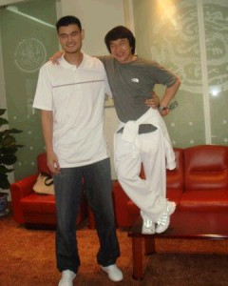
Activity 5 叠词练习(in pair)
他长得怎么样？
姚明长得又高又帅，眼睛小小的， 头发黑黑的 ， 耳朵大大的。 成龙呢？
http://exnba.com/articles-news/jackie-chan-yao-ming-elected-as-political-advisors-in-china/

Slide 52
Activity 5 叠词练习(in pair)
长得很可爱，
眼睛
头发
嘴巴
眉毛
http://www.fanpop.com/clubs/mulan/images/2471043/title/mulan-wallpaper-wallpaper

Slide 53
她长得怎么样？
眼睛
头发
眉毛
鼻子
http://www.tumblr.com/tagged/baby%20reading

Slide 54
他们长得怎么样 ？
http://www.themagazine.ca/2011/05/27/back-in-action-kung-fu-panda-2/#.UelrXo21GSo

Slide 55
Activity 6：Use the new words
Read the following questions/statements then circle the best answers with a partner.
1. Uasin Bolt 是世界上跑得最快的人，大家都叫他_______________________
1)腿毛飞 2)飞毛腿 3)毛飞腿
2. 他妈妈做的饭又_________ 又___________， 朋友们都非常喜欢吃。
1）好看....好吃 2） 难看..... 好吃 3）难看... 难吃。
3. 我每天早上，_________起床， __________洗澡，___________吃早饭。
1）先...然后...最后 2） 然后...先... 最后 3）先...先... 最后
4. 成龙个子高高的，眼睛小小的，你认为他____________ 怎么样？
1) 看得 2) 觉得 3）长得
5. 在学校，你喜欢_________学生还是喜欢________老师？
1) 当 2)是 3) 有

Slide 56
Activity 7 : Write an email
Students start to write his/her email in class. Teacher walks around to check and answer questions.
Graphic writing organizer
(www.sanchezclass.com/docs/story-map.do)

Slide 57
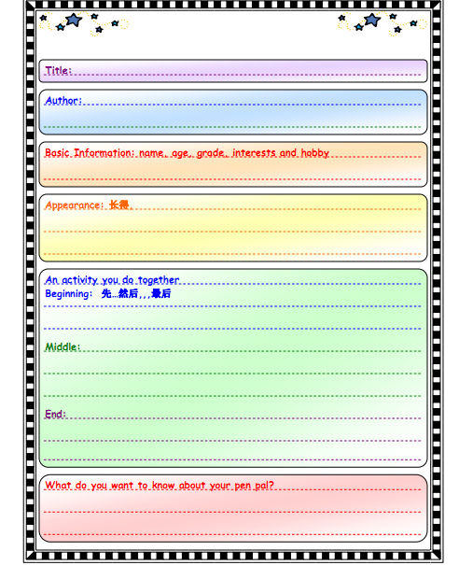
Graphic writing organizer

Slide 58
Homework
Complete the email, then edit the email using the graphic organizer.

